Slide 1
Black Body Radiation: (Introductory Lecture of Quantum Theory : Quantum Mechanics-I. PG Semester II) PHYPG2101
Presented by
Dr. Sakuntala Gupta
Associate Professor
Department of Physics
Raiganj University
India
Sakuntala_gupta@yahoo.com

Slide 2
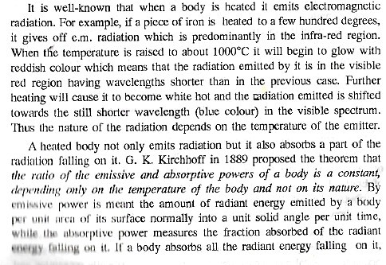
Introductory Lectures on Quantum Theory

Slide 3
Then its absorptive power is unity. Such a body is called a black body. Then according to Kirchhoff's theorem, "For a body of any arbitrary material emitting and absorbing thermal electromagnetic radiation at every wavelength in thermodynamic equilibrium, the ratio of its emissive power to its dimensionless co efficient of absorption is equal to a universal function only of radiative
wavelength and temperature. That universal function describes the perfect black-body emissive power".

Slide 7
