Slide 1
Ordinary Differential Equations Boundary Value Problems Dr. Rajib Mandal Department of Mathematics Raiganj University

Slide 2
14.1 Shooting Method for Solving Linear BVPs
We investigate the second-order, two-point boundary-value problem of the form
with Dirichlet boundary conditions
Or Neuman boundary conditions
Or mixed boundary condition

Slide 3
14.1 Shooting Method for Solving Linear BVPs
Simple Boundary Conditions
The approach is to solve the two IVPs
If the solution of the original two-point BVP is given by
y(x) = u(x) + Av(x) is found from the requirement that y(b) = u(b) + Av(b) = yb
→

Slide 4
14.3 Shooting Method for Solving Linear BVPs
EX14.1
convert to the pair of initial-value problems

Slide 5
14.1 Shooting Method for Solving Linear BVPs
General Boundary Condition at x = b
The condition at x=b involves a linear combination of y(b) and y’(b)
The approach is to solve the two IVPs
If there is a unique solution, given by

Slide 6
14.3 Shooting Method for Solving Linear BVPs
General Boundary Condition at Both Ends of the Interval
the approach is to solve two IVPs
If , there is a unique solution, given by

Slide 7
14.3 Shooting Method for Solving Linear BVPs
Ex 14.4
→
Ex 14.5
→

Slide 8
14.2 Shooting Method for Solving NonLinear BVPs
Nonlinear Shooting Based on the Secant Method
use an iterative process based on the secant method presented in Chapter 2
the initial slope ‘t’, begin with u’(a) = t(1) = 0, error is m(1) Unless the absolute value of m(1) is less than the tolerance, we continue by solving eq.

Slide 9
14.2 Shooting Method for Solving NonLinear BVPs
EX 14.6
→ y = 1/(x+1)

Slide 10
14.2 Shooting Method for Solving NonLinear BVPs
Nonlinear Shooting Using Newton’s Method begin by solving the initial-value problem Check for convergence:
if |m| < tol, stop;
Otherwise, update t:

Slide 11
14.2 Shooting Method for Solving NonLinear BVPs
EX 14.8

Slide 12
14.3 Finite Difference Method for Solving Linear BVPs
Replace the derivatives in the differential equation by finite-difference approximations (discussed in Chapter 11).
We now consider the general linear two-point boundary-value problem
with boundary conditions
To solve this problem using finite-differences, we divide the interval [a, b] into n subintervals, so that h=(b-a)/n. To approximate the function y(x) at the points we use the central difference formulas from Chapter 11:

Slide 13
Finite Difference Method for Solving Linear BVPs
Substituting these expressions into the BVP and writing as ____ as and as gives
Further algebraic simplification leads to a tridiagonal system for the unknowns viz.
where and .

Slide 14
Finite Difference Method for Solving Linear BVPs
Expanding this expression into the full system gives

Slide 15
Example 14.9 A Finite-Difference Problem
Use the finite-difference method to solve the problem
with y(0)=y(4)=0 and n=4 subintervals.
Using the central difference formula for the second derivative, we find that the differential equation becomes the system.
For this example, h = 1 ,i =1, y = 0, and i = 3, y = 0. Substituting this values, we obtain

Slide 16
Example 14.9 A Finite-Difference Problem
Combining like terms and simplifying gives
Solving, we find that y_1=13/7, y_2 = 18/7, and y_3 = 13/7.
We note for comparison that the exact solution of this problem is

Slide 17
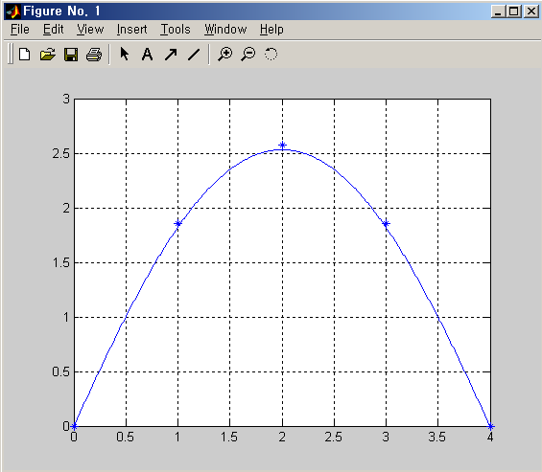
Example 14.9 A Finite-Difference Problem

Slide 18
Example 14.10 A Matlab Script for a Linear FDP.
The Matlab script that follows solves the BVP.
function S_linear_FD
aa = 0; bb = 3; n = 300;
p = 2*ones(1, n-1); q = -2*ones(1, n-1); r = zeros(1, n-1);
ya = 0.1; yb = 0.1*exp(3)*cos(3);
h = (bb-aa)/n; h2 = h/2; hh= h*h;
x = linspace(aa+h, bb, n);
a = zeros(1, n-1); b = a;
a(1:n-2) = 1 - p(1, 1:n-2)*h2; d = -(2 + hh*q);
b(2:n-1) = 1 + p(1, 2:n-1)*h2;
c(1) = hh*r(1) - (1+p(1)*h2)*ya;
c(2:n-2) = hh*r(2:n-2);
c(n-1) = hh*r(n-1) - (1 - p(n-1)*h2)*yb;
y = Thomas(a, d, b, c)
xx = [aa x]; yy = [ya y yb];
out = [xx' yy']; disp(out)
plot(xx, yy), grid on, hold on
plot(xx, 0.1*exp(xx).*cos(xx))
hold off

Slide 19
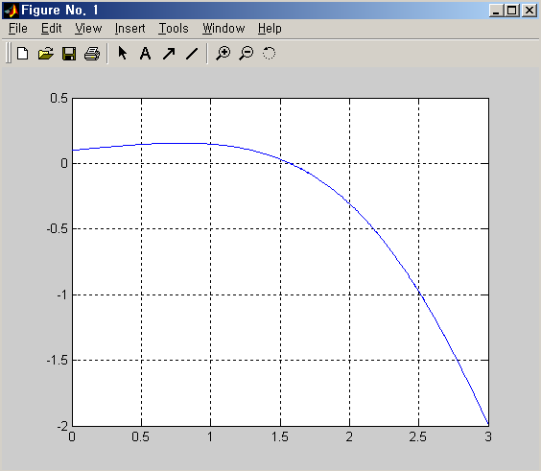
Example 14.10 A Matlab Script for a Linear FDP.

Slide 20
14.4 FDM for Solving Nonlinear BVPs
We consider the nonlinear ODE-BVP of the form
Assume that there are constants and such that
Use a finite-difference grid with spacing and let denote the result of evaluating at using for .
The ODE then becomes the system
An explicit iteration scheme, analogous to the SOR method
where and The process will converge for

Slide 21
Example 14.12 Solving a Nonlinear BVP by Using FDM
Consider again the nonlinear BVP
We illustrate the use of the iterative procedure just outlined by taking a grid with h = ¼. The general form of the difference equation is
where

Slide 22
Example 14.12 Solving a Nonlinear BVP by Using FDM
Substituting the rightmost expression for f_i into the equation for y_i, we obtain
The computed solution after 10 iterations agrees very closely with the exact solution.
function S_nonlinear_FD
ya = 1; yb = 2; a = 0; b = 1;
max_it = 10; n = 4; w = 0.1; ww = 1/(2*(1+w)); h = (b-a)/n
y(1:n-1) = 1
for k = 1:max_it
y(1) = ww*(ya+2*w*y(1)+y(2)+(ya^2-2*ya*y(2)+y(2)^2)/(4*y(1)));
y(2) = ww*(y(1)+2*w*y(2)+y(3)+(y(1)^2-2*y(1)*y(3)+y(3)^2)/(4*y(2)));
y(3) = ww*(y(2)+2*w*y(3)+yb+(y(2)^2-2*y(2)*yb+yb^2)/(4*y(3)));
end
x = [ a a+h a+2*h a+3*h b ]; z = [ ya y yb ];
plot(x, z), hold on, zz = sqrt(3*x+1); plot(x, zz), hold off

Slide 23
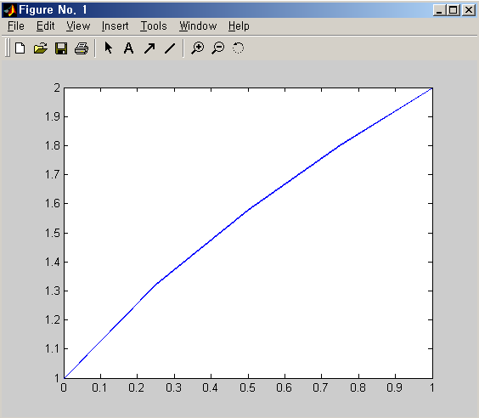
Example 14.12 Solving a Nonlinear BVP by Using FDM

